Slide 1
Vector Integral Calculus
Lecture 6
Application of the divergence theorem of Gauss:
Modelling of heat flow
Potential theory
Greens first formular
Stoke’s theorem

Slide 2
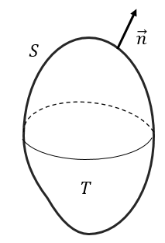

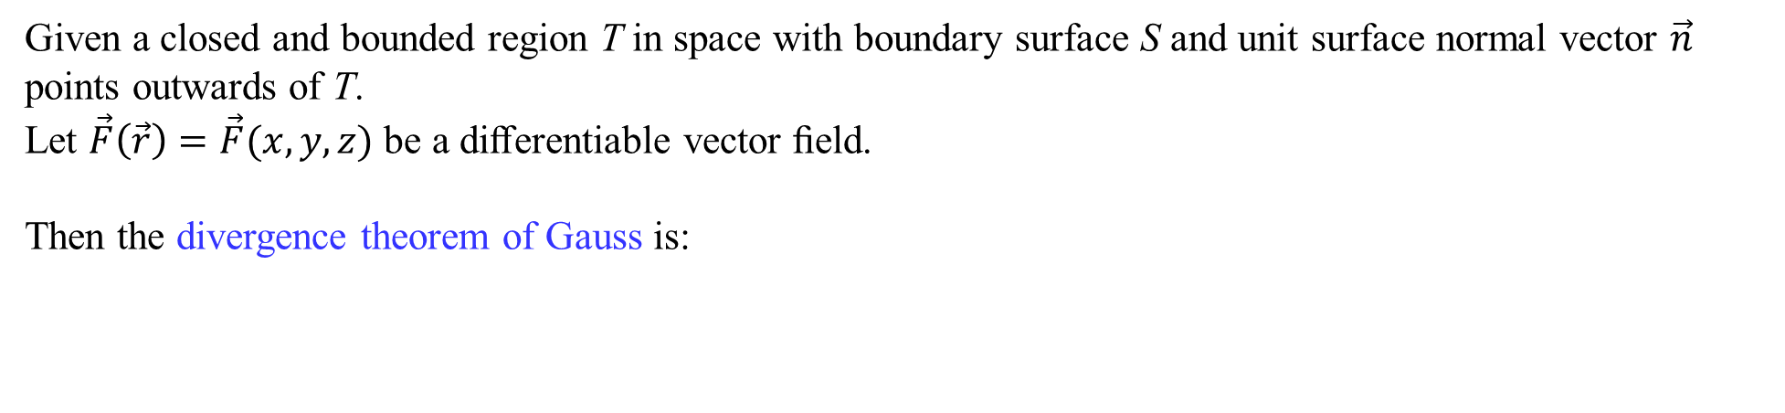
Divergence theorem of Gauss
Given a closed and bounded region T in space with boundary surface S and unit surface normal vector $\vec{n}$ points outwards of T.
Let $\vec{F}\left(\vec{r}\right)=\vec{F}(x,y,z)$ be a diﬀerentiable vector ﬁeld.
Then the divergence theorem of Gauss is:
The divergence theorem of Gauss relates a triple integral to a surface integral.

Slide 3
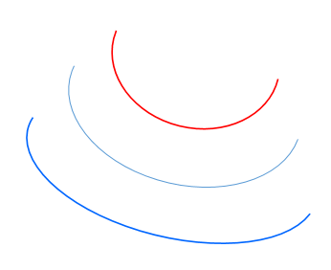
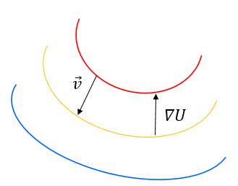
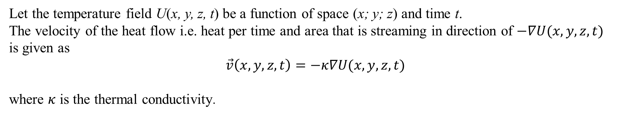

Modelling of heat flow
We want to set up a model for heat flow the so called heat equation.
From physical experiments :
In a body heat always flows in the direction from high to low temperature.
The rate of the flow is proportional to the gradient of the temperature.
Let the temperature field U(x, y, z, t) be a function of space (x; y; z) and time t.
The velocity of the heat flow i.e. heat per time and area that is streaming in direction of $−∇U(x,y,z,t)$
is given as
$$\vec{v}\left(x,y,z,t\right)=−κ∇U(x,y,z,t)$$
where $κ$ is the thermal conductivity.
$$\left(\frac{heat}{time∙area}\right)$$

Slide 4




Modelling of heat flow
Let T be a closed and bounded region with boundary surface S and with outwards pointing unit surface normal vector $\vec{n}$. And assume that T does not contain any heat sources or sinks.
The amount of heat leaving T per time is given as:
Laplace operator :
Gauss divergence theorem :

Slide 5






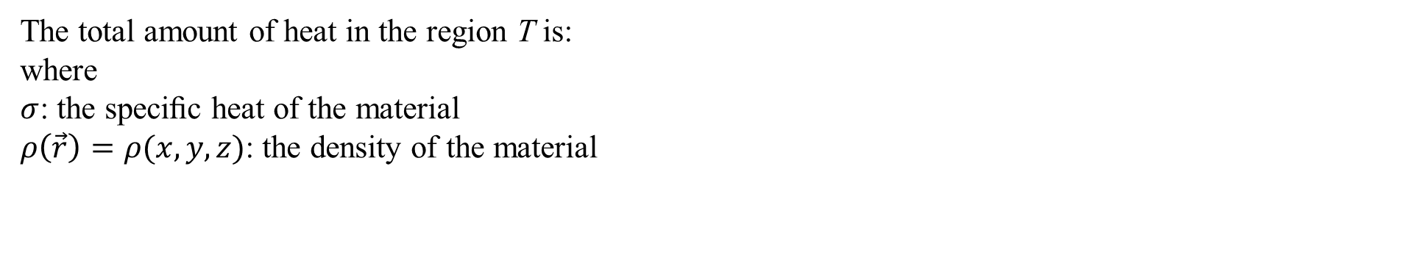



Modelling of heat flow
The total amount of heat in the region T is:
where
$σ$: the speciﬁc heat of the material
$ρ\left(\vec{r}\right)=ρ(x,y,z)$: the density of the material
Assume that the density is a constant: $ρ\left(\vec{r}\right)=ρ$
The rate of change of the total amount of heat H is:
The heat entering T must be:
$$⇔$$
Hence:
$$⇔$$
4

Slide 6




Modelling of heat flow
For the closed bounded region T:
it is then a necessity that: or
$${ ,c}^{2}=\frac{κ}{σρ}$$
The heat equation:
The solution is the temperature at a given point and at given time
Special case:
Steady heat flow; with no time dependency:
The heat equation is then a Laplace equation:

Slide 7

Potential theory
Potential theory is the theory of solving the Laplace equation for a scalar ﬁeld $f\left(\vec{r}\right):$
A solution $f\left(\vec{r}\right)$ is called the a harmonic function
An example of a harmonic solution is the scalar field $f\left(\vec{r}\right)=x^{2}−y^{2}$

Slide 8

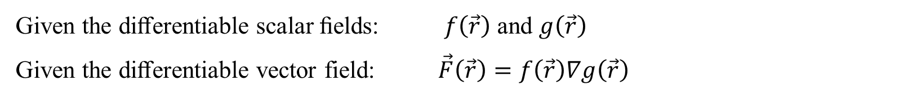
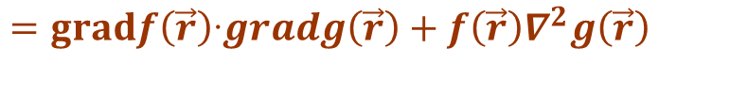
Green’s ﬁrst formula
Given the diﬀerentiable scalar ﬁelds: $f\left(\vec{r}\right)$ and $g\left(\vec{r}\right)$
Given the diﬀerentiable vector field: $\vec{F}\left(\vec{r}\right)=f\left(\vec{r}\right)∇g\left(\vec{r}\right)$
$$=f\left(\vec{r}\right)gradg\left(\vec{r}\right)$$
Then:
$$div\vec{F}\left(\vec{r}\right)=divf\left(\vec{r}\right)gradg\left(\vec{r}\right)=divf\left(\vec{r}\right)\left(g_{x}\left(\vec{r}\right),g_{y}\left(\vec{r}\right)\text{,} g_{z}\left(\vec{r}\right)\right)=$$
$$=gradf\left(\vec{r}\right)‧gradg\left(\vec{r}\right)+f\left(\vec{r}\right)∇^{2}g\left(\vec{r}\right)$$

Slide 9

Green’s ﬁrst formula
Now let T be a closed and bounded region with boundary surface S and
outwards pointing unit surface normal vector $\vec{n}$.
Since $f\left(\vec{r}\right)$ is a scalar function then:
$$\vec{F}\left(\vec{r}\right)∙\vec{n}\left(r\right)=\vec{n}\left(r\right)‧\vec{F}\left(\vec{r}\right)=\vec{n}\left(\vec{r}\right)∙f\left(\vec{r}\right)gradg\left(\vec{r}\right)=f\left(\vec{r}\right)\vec{n}\left(\vec{r}\right)∙∇g\left(\vec{r}\right)=f\left(\vec{r}\right)D_{\vec{n}\left(\vec{r}\right)}g(\vec{r})$$
$D_{\vec{n}\left(\vec{r}\right)}g(\vec{r})$
is the directional derivative of $g(\vec{r})$ in the direction of the outwards pointing unit surface normal vector $\vec{n}$.
Using Gauss divergence theorem:
and
$$div\vec{F}\left(\vec{r}\right)=gradf\left(\vec{r}\right)‧gradg\left(\vec{r}\right)+f\left(\vec{r}\right)∇^{2}g\left(\vec{r}\right)$$
We get
Greens first formular:

Slide 10

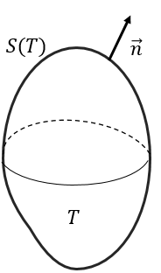
Green’s ﬁrst formula
Ex.: Let T be a closed and bounded region with closed boundary surface S(T) with outwards pointing unit surface normal vector $\vec{n}$. And let $f(\vec{r})$ be a harmonic function that is continuous and zero on S(T).
We then have:
Using Greens first formular with $f\left(\vec{r}\right)=g(\vec{r})$:
We get :
This implies:
= constant
Since: $f\left(\vec{r}\right)=0$ on S(T) then we have $f\left(\vec{r}\right)=0$ in T
This is an important property of harmonic functions:
$f\left(\vec{r}\right)=0$ on a closed surface $S\left(T\right)⟹f\left(\vec{r}\right)=0$ in T

Slide 11

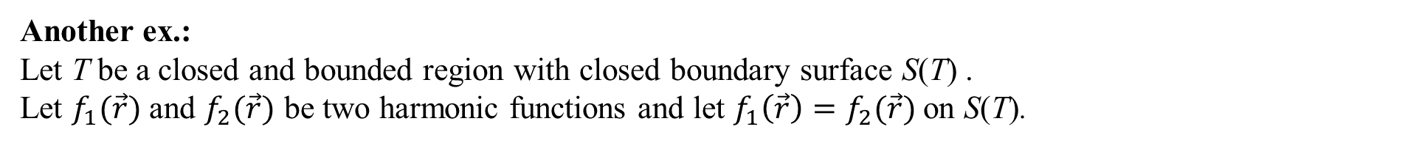
Green’s ﬁrst formula
Another ex.:
Let T be a closed and bounded region with closed boundary surface S(T) .
Let $f_{1}(\vec{r})$ and $f_{2}(\vec{r})$ be two harmonic functions and let $f_{1}\left(\vec{r}\right)=f_{2}(\vec{r})$ on S(T).
For harmonic functions we have: $f\left(\vec{r}\right)=f_{1}\left(\vec{r}\right)−f_{2}(\vec{r})$ is also a harmonic function
We have :
$f\left(\vec{r}\right)=0$ on a closed surface $S\left(T\right)⟹f\left(\vec{r}\right)=0$ in T
Consequently: $f_{1}\left(\vec{r}\right)−f_{2}\left(\vec{r}\right)=0 in T$ and thus $f_{1}\left(\vec{r}\right)=f_{2}\left(\vec{r}\right) in T$
This is an important property of harmonic functions $f_{1}(\vec{r})$ and $f_{2}(\vec{r})$:
$f_{1}\left(\vec{r}\right)=f_{2}(\vec{r})$ on a closed surface $S\left(T\right)⟹f_{1}\left(\vec{r}\right)=f_{2}(\vec{r})$ in T

Slide 12
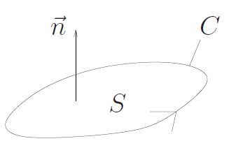
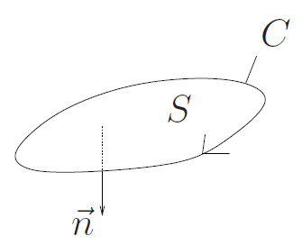

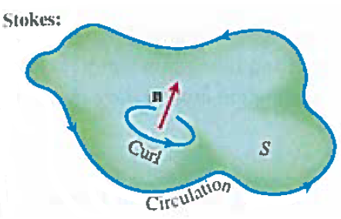
Vector Integral Calculus
Stoke’s theorem
J. Schmiegel: Lecture notes
J. Hass, D. Weir, G. Thomas:
University Calculus: Early Transcendentals

Slide 13
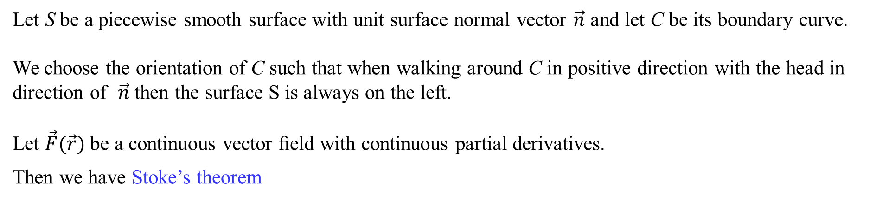
Stoke’s theorem
Let S be a piecewise smooth surface with unit surface normal vector $\vec{n}$ and let C be its boundary curve.
We choose the orientation of C such that when walking around C in positive direction with the head in direction of $\vec{n}$ then the surface S is always on the left.
Let $\vec{F}(\vec{r})$ be a continuous vector ﬁeld with continuous partial derivatives.
Then we have Stoke’s theorem
J. Schmiegel: Lecture notes
Note
when calculating the line integral the parametric representation of C must
be such that the orientation of C has the right direction
Note that Green’s theorem in the plane is a special case of Stoke’s theorem
J. Hass, D. Weir, G. Thomas:
University Calculus: Early Transcendentals

Slide 14
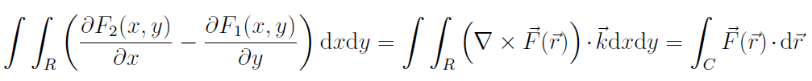
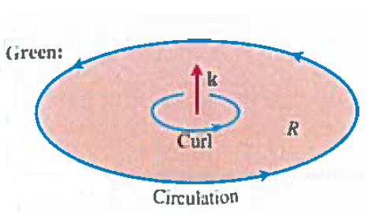
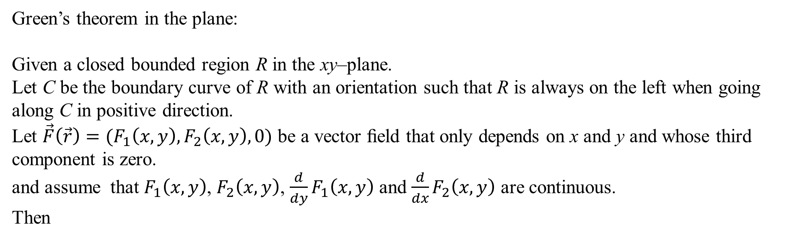
Green’s theorem in the plane
Green’s theorem in the plane:
Given a closed bounded region R in the xy–plane.
Let C be the boundary curve of R with an orientation such that R is always on the left when going along C in positive direction.
Let $\vec{F}\left(\vec{r}\right)=(F_{1}\left(x,y\right),F_{2}\left(x,y\right),0)$ be a vector ﬁeld that only depends on x and y and whose third component is zero.
and assume that $F_{1}\left(x,y\right)$, $F_{2}\left(x,y\right)$, $\frac{d}{dy}F_{1}\left(x,y\right)$ and $\frac{d}{dx}F_{2}\left(x,y\right)$ are continuous.
Then
J. Hass, D. Weir, G. Thomas:
University Calculus: Early Transcendentals

Slide 15
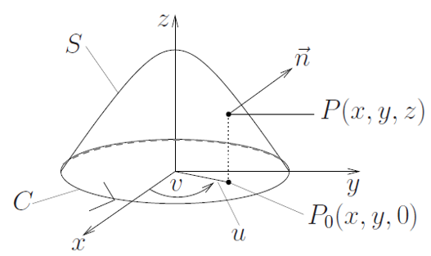
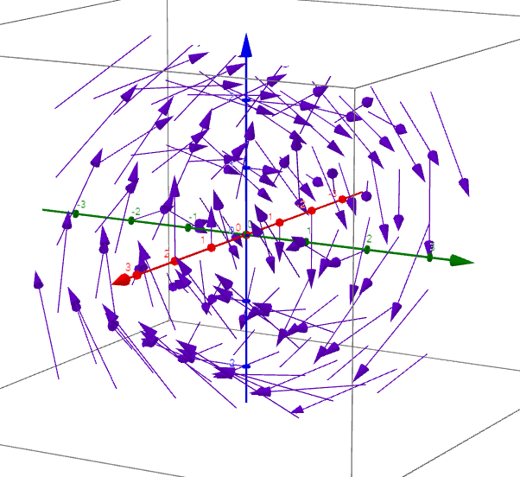
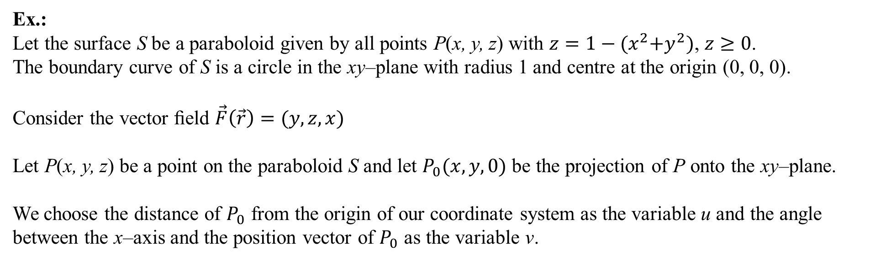
Stoke’s theorem
Ex.:
Let the surface S be a paraboloid given by all points P(x, y, z) with $z=1−{(x}^{2}+y^{2})$, $z≥0$.
The boundary curve of S is a circle in the xy–plane with radius 1 and centre at the origin (0, 0, 0).
Consider the vector ﬁeld $\vec{F}\left(\vec{r}\right)=(y,z,x)$
Let P(x, y, z) be a point on the paraboloid S and let $P_{0}(x,y,0)$ be the projection of P onto the xy–plane.
We choose the distance of $P_{0}$ from the origin of our coordinate system as the variable u and the angle between the x–axis and the position vector of $P_{0}$ as the variable v.
J. Schmiegel: Lecture notes

Slide 16
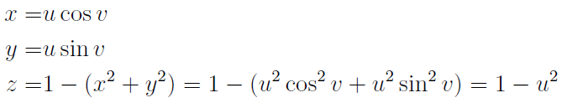



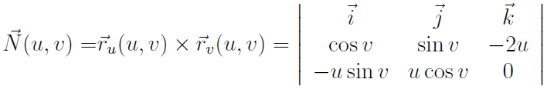


Stoke’s theorem
Ex. cont.:
We get:
The parametric representation of S:
J. Schmiegel: Lecture notes
$$0≤u≤1 0≤v≤2π$$
The tangent vectors:
The surface normal vector:

Slide 17


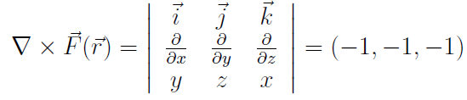
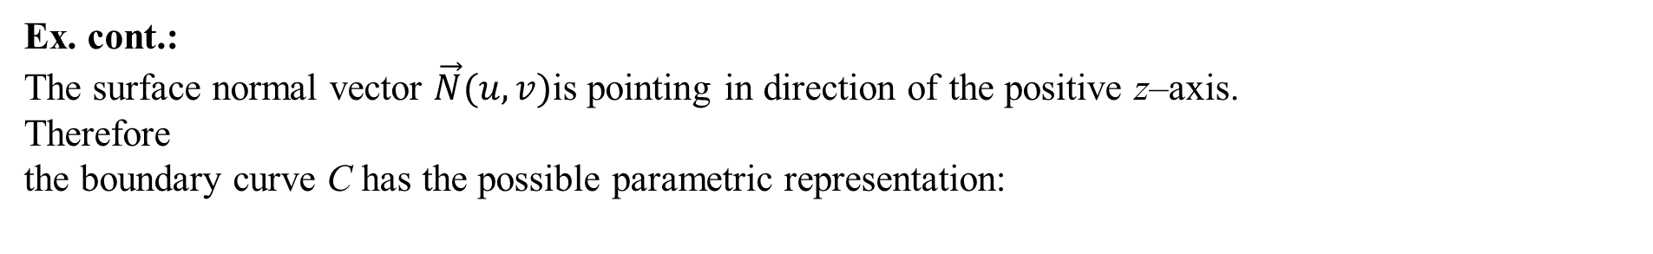

Stoke’s theorem
Ex. cont.:
The surface normal vector $\vec{N}(u,v)$is pointing in direction of the positive z–axis.
Therefore
the boundary curve C has the possible parametric representation:
The tangent vector of C:
$$\vec{F}\left(\vec{r}\right)=\left(y,z,x\right):$$
The rotation vector of the vector field
J. Schmiegel: Lecture notes

Slide 18

Stoke’s theorem
Ex. cont.:
The left hand side of Stoke’s theorem gives:
J. Schmiegel: Lecture notes

Slide 19




Stoke’s theorem
Ex. cont.:
The right hand side of Stoke’s theorem gives:
J. Schmiegel: Lecture notes
$$\vec{F}\left(\vec{r}\right)=(y,z,x)$$

Slide 20
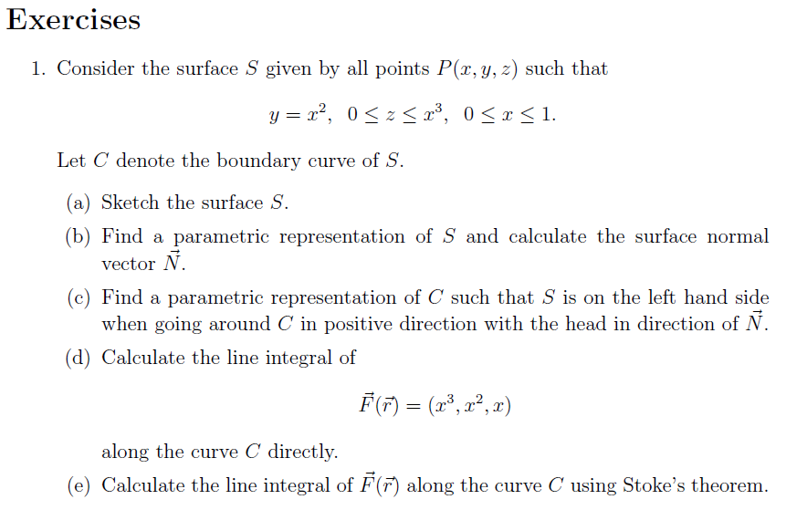
We are doing exercises from lecture notes 6

Slide 21

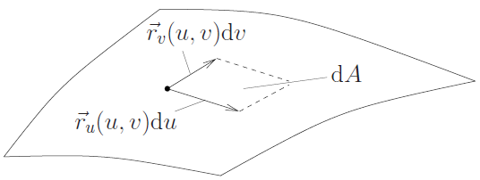

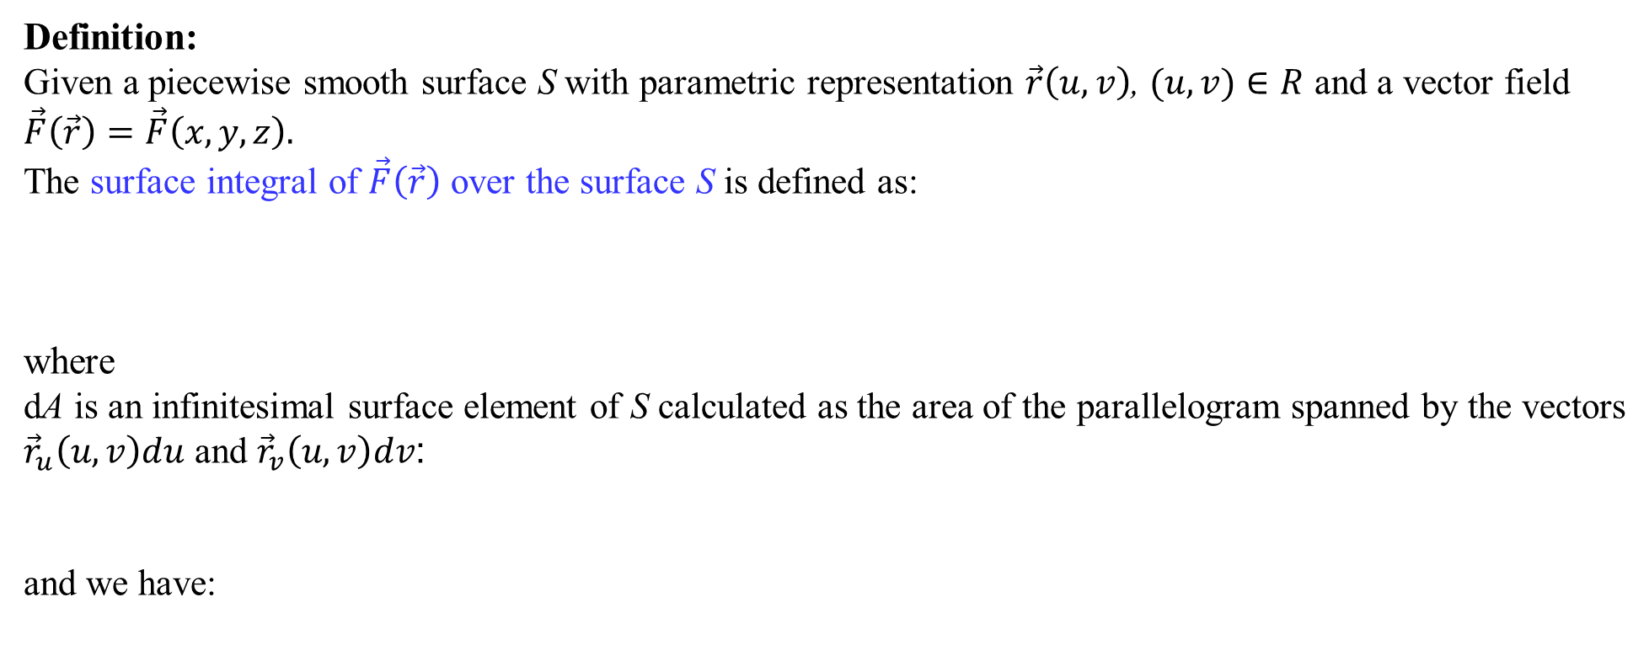
Surface integrals
Definition:
Given a piecewise smooth surface S with parametric representation $\vec{r}\left(u,v\right)$, $(u,v)∈R$ and a vector field $\vec{F}\left(\vec{r}\right)=\vec{F}\left(x,y,z\right).$
The surface integral of $\vec{F}\left(\vec{r}\right)$ over the surface S is defined as:
where
dA is an infinitesimal surface element of S calculated as the area of the parallelogram spanned by the vectors
${\vec{r}}_{u}\left(u,v\right)du$ and ${\vec{r}}_{v}\left(u,v\right)dv$:
and we have:
J. Schmiegel: Lecture notes

